Slide 1
Facial Recognition
Vishal Patel, Doulos Htet, Mihir Parekh, Cristian Lopez

Slide 2



Facial Recognition
We are going to be testing facial recognition by uploading images into S3 bucket and seeing if we get a match

Slide 3
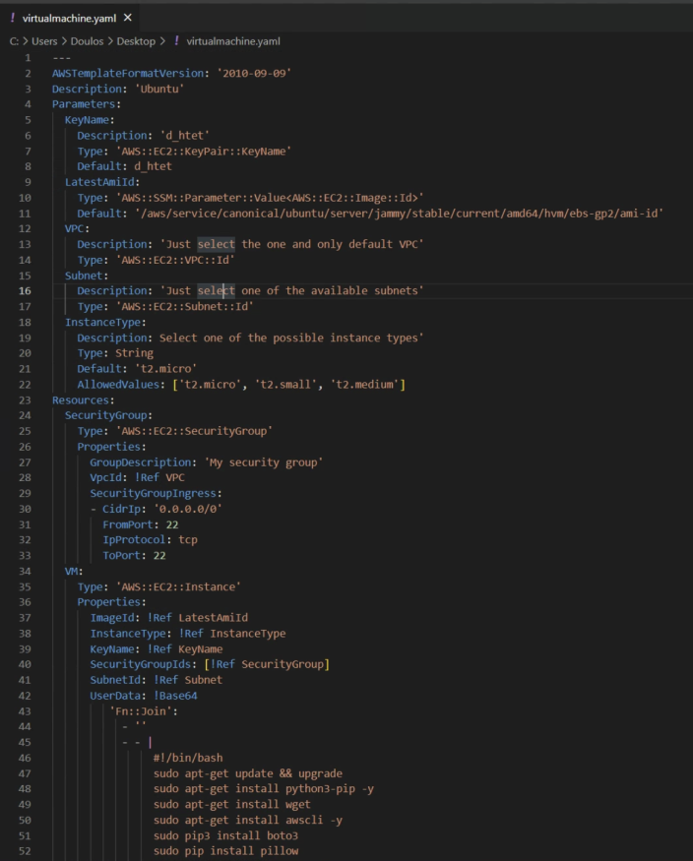
Cloud Formation
We are using Cloud Formation because it provides us with pre-built yaml file which is easier to edit and customize
We customized the yaml file to automate all the commands that need to be run for cloud formation
Then we are going to launch an EC2 instance with the yaml file which will automate all the commands for cloud formation

Slide 4

EC2
We are using EC2 instance because this is going to provide us with a scalable environment to work with
Once the EC2 is launched, it will use the yaml file to automatically run the commands for cloud formation
This will take time but it will provide us with a suitable environment which has all the code, libraries and necessary files needed

Slide 5
S3 and DynamoDB
We chose to use S3 bucket to store the images we send to be analyzed
This is a simple cloud storage resource which is best suitable for our purpose
We will store an image here with a key and the key will be the name of the image
DynamoDB uses hashing and B-trees which is how our software will search if a face exists or not
This will run through the facial recognition api and try to retrieve the hash of the key with all the information of the picture we send

Slide 6

Lambda
We have 1 function that is going to run our code to compute everything that is going to be happening with the S3 bucket, cloud formation, and DynamoDB
If an image is uploaded to S3 and the name is uploaded to DynamoDB, then this function will trigger the facial recognition api

